Slide 1
The BrainDemy Website
Content

Slide 2
BrainQuarter
BrainQuarter
Courses
Know More
Resources
Search…
Sign Up

Slide 3


Hero / Landing Section
100% Satisfaction Guarantee
Feeling brainy? Let’s think outside the skull together.
You’ve got the curiosity. We’ve got the course for it.
Let’s turn overthinking into overachieving.
CTA Button: Let’s Brain It On!
Have any Question? 7709566375
(India)
Unemployment rate:
5.1%
Empower
Through Education
5.1%

Slide 4




TOP INSTRUCTORS AROUND THE WORLD
Get To Know About Us
Meet Mentors Who Turn Mentors Who Shape Talent into Industry Assets
We’re bringing in creators, coders, marketers, designers, coaches, and brain hackers from every corner of the internet.
We’re not here to just teach.
We’re here to transform.
CTA Button: Discover more
Expert Tutors
Interactive Lessons
Ambitious Students
Live Sessions

Slide 5
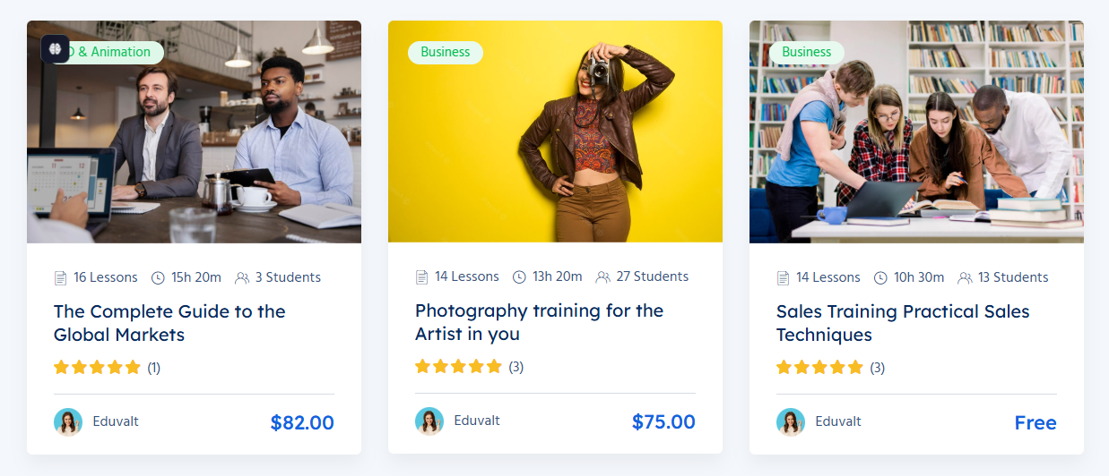
📚 OUR FEATURED COURSES
Welcome to Your New Space
Our Featured Courses
All Courses
Business
Design + Ai
Graphic Design
Digital Marketing

Slide 6
BROWSE BY CATEGORIES
Unique online courses
Browse By Categories
CTA Button: BrainDemy Categories
Fundamental
06 Courses
Marketing
09 Courses
Communication
08 Courses
Graphic Design
13 Courses
Digital Marketing
05 Courses

Slide 7
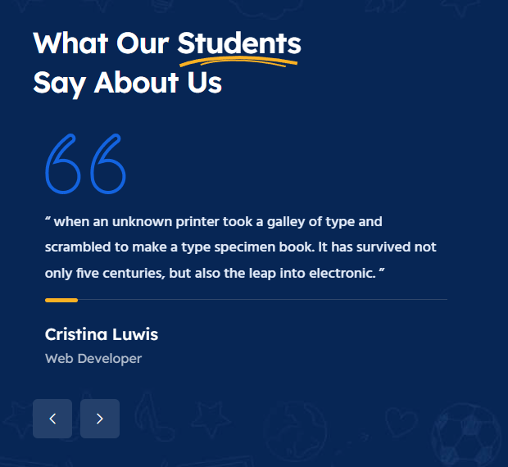
STUDENT TESTIMONIALS
Reference Image:
Brains, goals, and big wins— What our students Say About Us
Sample Copy:
“I used to scroll. Now I strategize.
Braindemy made me a creator, a closer, and a confident communicator”.
Name:
Designation:

Slide 8

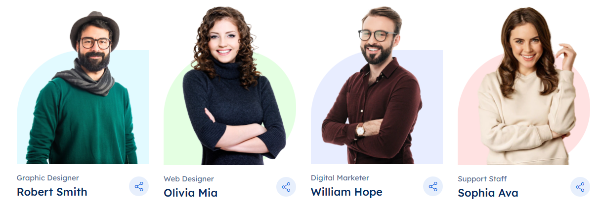

MENTORS SECTION
Reference:
Our Qualified People Matter
Our mentors – a part life-changers.
CTA Button: All Mentors
Designation
Full Name
Join Big Brainiacs. Bigger Hearts.
Our mentors are part brainiacs, part life-changers.
They're the kind who reply to your doubts with memes and insights.
CTA Button: Become A Mentor

Slide 9
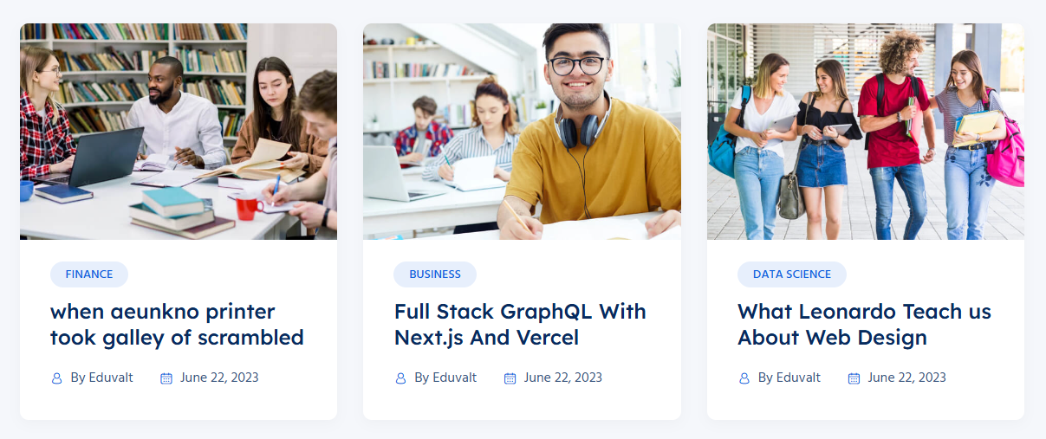
BLOG / RESOURCE CENTER
Smart Minds Never Stop Learning
Brainy Bytes & Blog Drops
Quick hacks, deep dives, and creative firecrackers. Our blog isn’t just helpful—it’s habit-forming.
CTA: Fuel My Brain
Industry Insights
Global & Social Awareness
Career & Future Skills
Case Studies: From Classroom to Industry
Rural to Global: Student Changemakers
Emerging Jobs of
the Future
By Braindemy
By Braindemy
By Braindemy

Slide 10

Subscribe to Newsletters
Let’s Join To Our NewslettersBrainy Bytes & Blog Drops
CTA: Subscribe Now
Keep it same for now

Slide 11
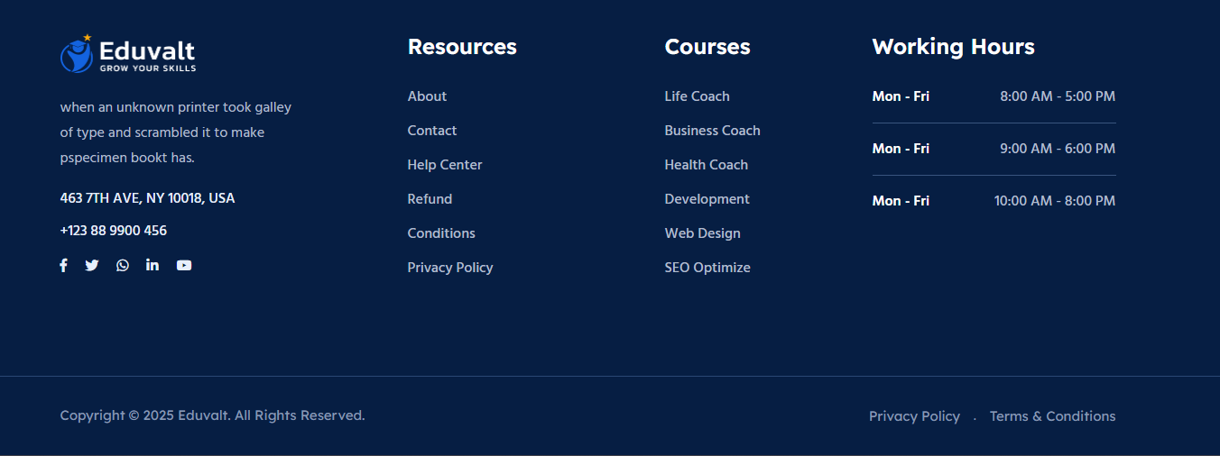
Sitemap (Footer)
Replace with Our Brand Logo

Slide 12
Courses
BrainQuarter
Courses
Know More
Resources
Search…
Sign Up

Slide 13
🗂️ Category List (Main Filters)
Digital Marketing
Branding & Identity
Content Creation
AI & Automation Tools
Website & App Development
Graphic Design
UI/UX Design
Public Speaking
Coaching & Life Design
Mental Wellness & Mind Hacks
Business & Entrepreneurship
Freelancing & Monetization
SEO & Blogging
Email Marketing & Funnels
Sales Strategy
Photography & Reels
🗂️ Category List (Main Filters)

Slide 14
🏷️ Tags (Topics for Filtering)
Tags
Canva Design
Instagram Reels
ChatGPT Prompting
YouTube Monetization
Personal Branding
Productivity Tools
Midjourney AI
Digital Detox
Figma UI
Google Ads
Copywriting Hacks
Affiliate Marketing
Time Management
Client Pitching
Zapier Workflows
📶 Level Filter
Level
All Levels
Beginner
Intermediate
Advanced
💸 Price Filter
Price
Free
Paid

Slide 15
Digital Marketing
Branding & Identity
AI Tools & Automation
Website & App Development
UI/UX & Product Design
Canva & Visual Design
Reels & Video Content
Copywriting & Storytelling
AI for Kids
ChatGPT
Midjourney
Notion AI
Prompt Engineering
AI Tools
Automation (Zapier/Make)
Instagram Reels
Video Editing (CapCut, InShot)
Hook Writing
Social Content Strategy
YouTube Growth
Viral Trends
Canva
Figma
Adobe Photoshop
Adobe XD
Moodboarding
Poster Design
UI/UX
Personal Branding
LinkedIn Strategy
Email Sequences
Copywriting
Sales Funnels
SEO
Meta Ads (Facebook/Instagram)
Growth Hacking
Sales Funnels & Email Marketing
Public Speaking & Confidence
Personal Branding & LinkedIn
Freelancing & Entrepreneurship
Kids Skill Academy (Class 5–10)
Mental Wellness & Mind Hacks
Career Coaching & Life Design

Slide 16
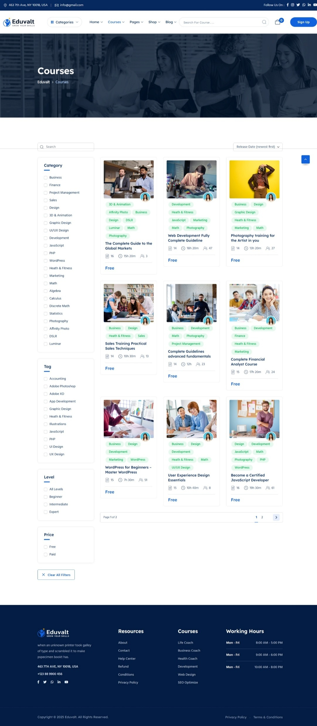
WordPress
Webflow
Wix
HTML/CSS
JavaScript Basics
No-Code Tools
Elementor
Time Management
Productivity Hacks
Digital Detox
Mind Mapping
Emotional Intelligence
Journaling
Mental Health
Freelancing
Resume & Portfolio
Client Pitching
Career Growth
Public Speaking
Confidence Building
Life Coaching

Slide 17
🧒 Tags for Kids Skill Academy (Class 5–10)
📘 Academic Skills
Class 5–10
Mathematics
Science Projects
English Grammar
Logical Reasoning
Olympiad Prep
Social Studies
💻 Tech & Digital Skills
Scratch Coding
HTML & CSS Basics
Student Websites
Computer Basics
Google Suite
Internet Safety
🎨 Creative & Design Skills
Canva for Kids
Drawing & Posters
Storytelling
Digital Stories
Art & Design
🤖 AI & Robotics for Kids
AI for Kids
Mini Robots
Smart Circuits
Sensor Projects
Tech Fun
🎙 Communication & Life Skills
Public Speaking
Debate Practice
Confidence Building
Role-Play Skills
Speech Writing

Slide 18
Know More
BrainQuarter
Courses
Know More
Resources
Search…
Sign Up

Slide 19
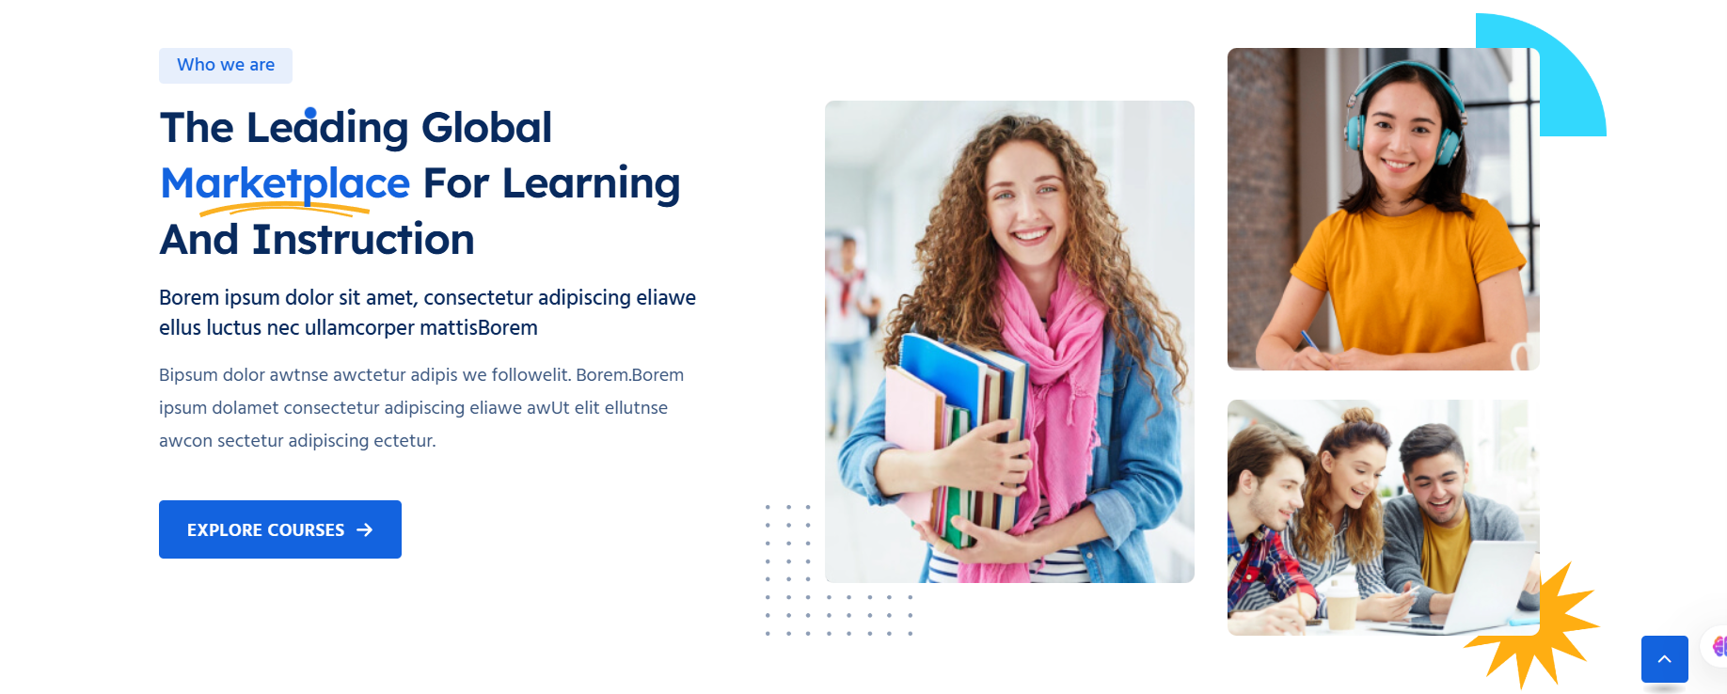
Know more
Who we are
wkoThe Smartest Spot on the Internet to Learn What Actually Matters
At Braindemy, we don’t believe in boring. We believe in bold.
We built this academy because the world doesn’t need more “meh” courses—it needs real skills taught by real people, in a really awesome way.
From coding to confidence, AI tools to advertising, public speaking to pixel-perfect design—we’ve curated the courses your future self will high-five you for.
And yeah, we sprinkle in a little fun too.
(Okay, a lot.)
CTA Button:
🚀 "Explore Courses Now"
Reference:

Slide 20
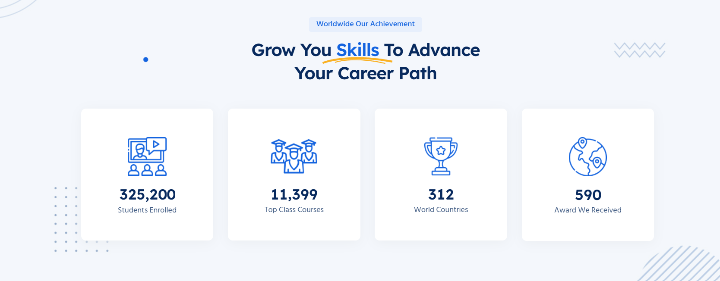
🌍 Braindemy: Ready to Impact the World
Reference:
Grow Your Skills. Shape Your Future.
We’re just getting started — and we’re thinking big.
🧠 The Vision We’re Building
🌱 What's Coming
💡 Our Goal
🎓 Students to Empower
100,000+
📘 Courses in the Making
500+
🌍 Countries to Reach
50+
🏆 Awards to Earn
Countless

Slide 21
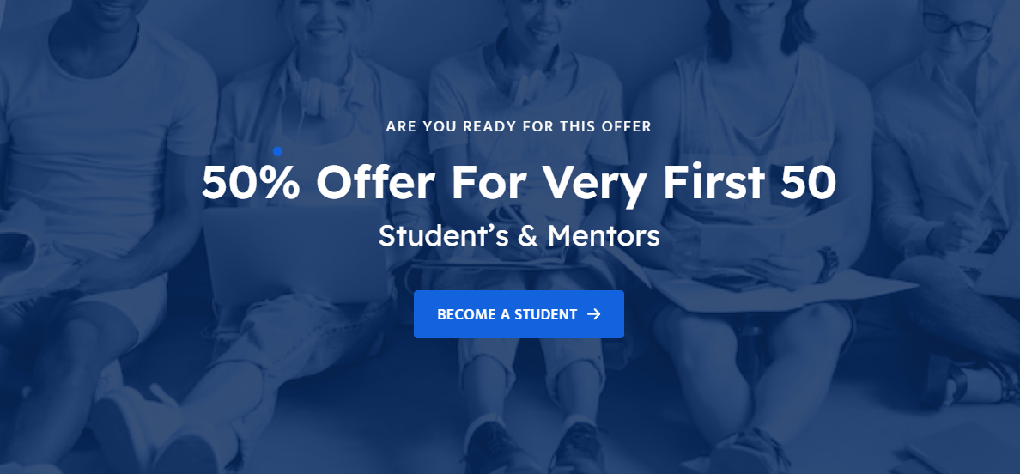
Reference:
ARE YOU READY FOR THIS OFFER 10% Offer For Very First 50 Student’s & Mentors

Slide 22

Reference:c
🧠 India’s Rising Learning Hub
Curated content. Passionate instructors. Skills that actually pay off.
🎓 Real Mentors. Real Skills.
Learn directly from experienced professionals in design, marketing, tech, and more — the way it’s meant to be.

Slide 23
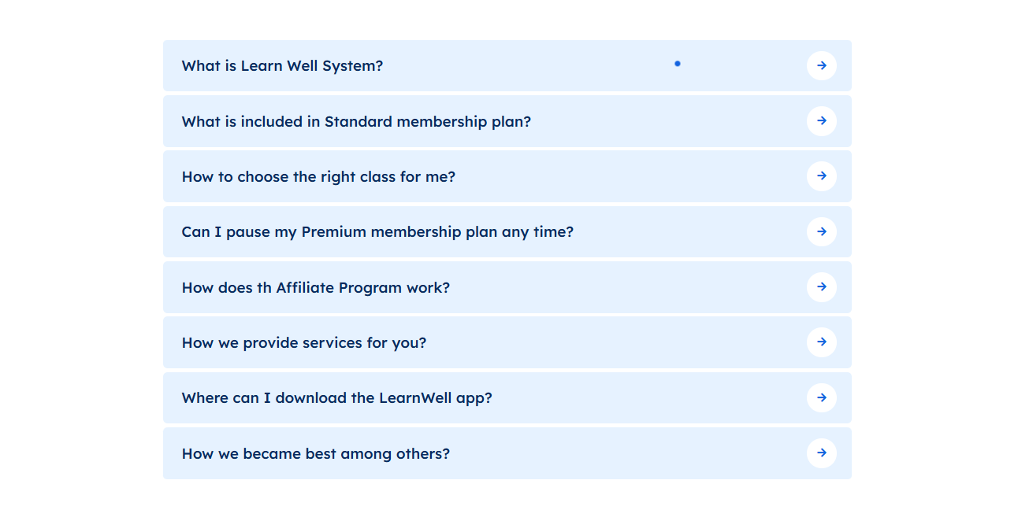

Slide 24
FAQ Questions & Answers (rephrased with your tone):
What is the Braindemy learning system all about?
  Answer: Our learning system is like a personal brain gym – dynamic, engaging, and designed to stretch your mind! We focus on hands-on skills, real-world application, and a whole lot of fun. No boring lectures, just brain-boosting brilliance.
What’s included in a Braindemy membership plan?
  Answer: Glad you asked, future brainiac! Our membership plans are packed with perks. Think unlimited access to mind-blowing courses, direct mentor insights, exclusive community access, and secret brain hacks. Specifics vary by plan, so dive into our options for the full scoop!
Reference:

Slide 25
How does the Braindemy Affiliate Program work?
  Answer: Love Braindemy and want to spread the brainy goodness? Our Affiliate Program lets you earn by sharing the brilliance! You get a unique link, share it with your network, and when they join, you get rewarded. It's a win-win for all the smart folks out there!
What kind of magical services do you provide at Braindemy?
  Answer: We're not just about courses – we're about transformation! We offer cutting-edge learning in AI, digital marketing, design, coding, mental well-being, public speaking, and more. Think skill upgrades, confidence boosts, and a whole new operating system for your life.
Where can I download the Braindemy app?
  Answer: Your brain on the go! Our app is your pocket-sized portal to brilliance. You can download it from the App Store (for Apple brains) and Google Play (for Android adventurers). Search for "Braindemy" and get ready to learn anywhere, anytime.
What makes Braindemy smarter than all the other learning platforms?
  Answer: We’re not just smart; we’re soul-powered! We blend curiosity, creativity, and a dash of caffeine to deliver courses that actually stick. Our mentors are hilarious, our content is fluff-free, and our community is a brainiac playground. Basically, we turn learning into a party.

Slide 26
How do I pick the perfect course for my brain goals?
  Answer: Feeling overwhelmed by the brilliance? Don't stress your synapses! Our course descriptions are packed with details, skill levels, and what you'll gain. Plus, our brain-savvy support team is always ready to chat and guide you to your ideal learning adventure. Ping us!
Can I put my Premium Braindemy membership on brain-pause?
  Answer: Life happens, even for the most dedicated learners! Yes, you can usually pause your Premium membership. Check your account settings or ping our Brain Team for the exact details and how to hit that pause button without losing your progress.

Slide 27
Resources
BrainQuarter
Courses
Know More
Resources
Search…
Sign Up

Slide 28
📧 NEWSLETTER SIGNUP
Reference:
"Don’t worry, be brainy."
Smart emails. Zero spam. Max learning.
Sign up and unlock ideas you didn’t know you needed.
CTA:
"Sign Me Up for Smart Stuff"

Slide 29
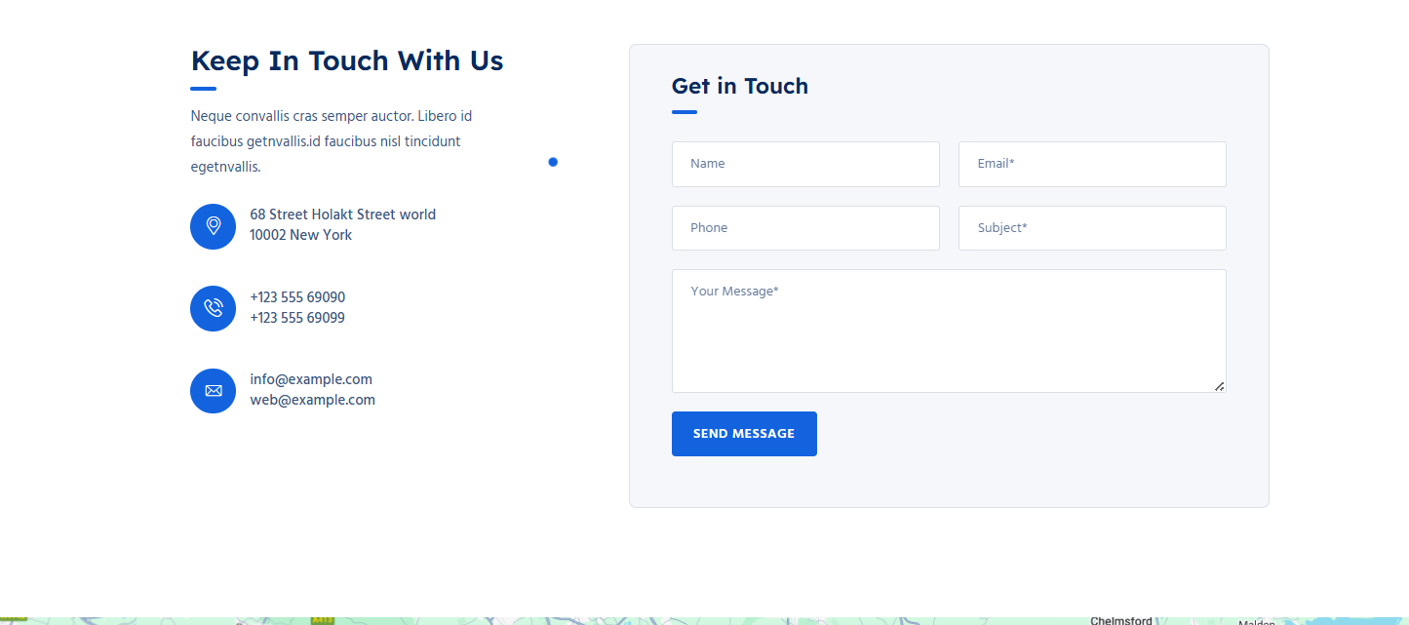
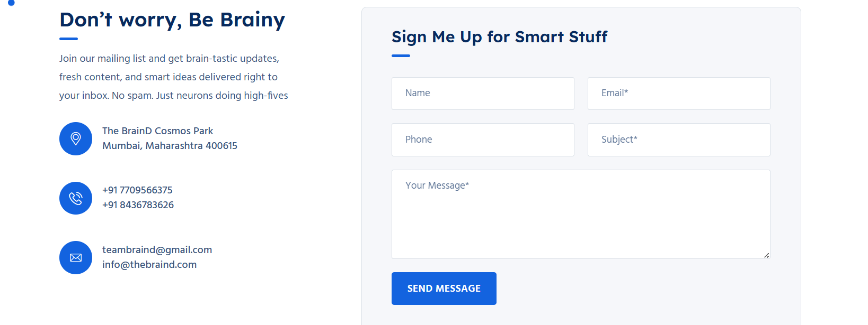
Reference:

Slide 30
Form
📞 CONTACT SECTION
❓ FAQ SECTION
Title:
"Lost in your own head? Let us help you out."
Copy:
We’re friendly. We’re fast. And we actually reply.
Whether it’s a tech glitch, a big idea, or a course confusion—ping us!
CTA:
"Ping the Brain Team"
Headline:
"Mind your brain-ness—FAQs incoming."
Intro Text:
Confused? Curious? Craving clarity? Our FAQs are smarter than Google on a good day.

Slide 31
💡 PHILOSOPHY SECTION – Braindemy DNA
🌀 BONUS MICROCOPY
Headline:
"Thinking is our cardio. And we never skip brain day."
Body Copy:
We mix curiosity, creativity, and caffeine to build courses that stick.
No fluff. No filler. Just the skills you need, delivered with soul.
Loading:
"Just a sec—neurons aligning…"
Form Success:
"Brainwave received! We’ll hit you back with brilliance soon."
Course Completed:
"Boom! Your brain just got a standing ovation. You crushed it."

Slide 32
🔁 404 PAGE
Headline:
"Oops! Your brain’s GPS rerouted us."
Copy:
This page took a snack break. Let’s get you back to brilliance.
CTA:
"Back to Brain Base"

Slide 33
User Registration Form Apply to Inspire
Form Name | Purpose | Fields | CTA / Button
1. User Registration Form | Allow students to sign up and join | - Full Name - Email Address - Phone Number - Password - Confirm Password - Profile Type - Interests - Referral Code (Optional) | Let’s Brain It On

Slide 34
Contact / Support Form
General queries and support requests
Full Name
- Email
- Subject
- Message
- Priority (Low, Medium, High)
Send My Brain Ping
Newsletter Signup Form
Grow email subscriber list
- First Name - Email - Interests (AI, Marketing, Design, etc.)
Fuel My Brain

Slide 35
Apply to Inspire
User Login Form
Secure user login
- Email
- Password
- Forgot Password? (link)
Enter Brain Mode
. Instructor Application Form
For mentors to apply
Full Name
- Email
- Phone Number
- LinkedIn
- Area of Expertise
- Portfolio Link
- Upload Resume
- Why Braindemy?
- Availability

Slide 36
Collect student details during course join
Course Enrollment Form
- Full Name
- Email
- Selected Course (auto)
- Payment Status
- Agree to Terms (checkbox)
Start Brainstorming Now
Course Feedback Form
- Course Name
- Rating (1–5)
- What You Loved
- Suggestions
- Recommend (Y/N)
- Upload Testimonial Video (optional)
Drop That Brainwave!

Slide 37
Password Reset Form
For users to recover accounts
Parent Consent Form
Required permission for children below 18
- Email - OTP / Reset Link
Child Name
- Grade/Class
- Parent Name
- Email
- Phone
- Consent Checkbox
- Signature Upload
Give Consent
Reset & Reboot

Slide 38
🔍 BROWSE BY CATEGORIES
"Brain Buffet: Pick Your Flavor“
Updated Categories
🤖 AI Tools & Smart Tech
Unlock the power of tools like ChatGPT, Midjourney, Notion AI & more.
📱 Digital Marketing & Ads Mastery
Crush SEO, Reels, Meta ads, email flows—basically everything trending.
🎨 Visual Communication & Branding
Design like a pro. Speak in pixels. Think in moods.
📈 Marketing & Sales Funnels
Learn the art (and science) of conversions, persuasion & performance.
💻 Website & App Development
From zero to launch—code your first site or app with confidence.

Slide 39
Continue
🧒 Kids Skill Academy (Class 5–12)
School can’t keep up. We do. Coding, creativity & confidence, for the next-gen.
🧠 Mental Health & Mind Hacks
Handle stress like a CEO. Sleep better. Think sharper. Live lighter.
🎙️ Public Speaking & Confidence
Pitch like Shark Tank. Speak like TED. Own every room you walk into.
🧑‍💼 Coaching, Leadership & Life Design
You don’t just grow here. You glow here. Build mindset, meaning & magic.

Slide 40
🧠 Sidebar Filters — Rewritten for Braindemy
🧿 Tags
🧠 Category
ChatGPT
Canva
Meta Ads
Notion AI
UI/UX
Brain Hacks
Coding for Kids
Public Speaking
Funnels
Mental Focus
WordPress
Email Automation
Motion Design
Canva Pro
Digital Marketing & Branding
AI Tools & Smart Tech
Visual Communication
Website & App Development
Mental Health & Productivity
Public Speaking & Confidence
Kids Academy (Class 5–12)
Coaching & Leadership
📈 Level
Beginner Brainiac
Getting Brainy
Full Brain Mode
Genius Unlocked
🧠 Footer Links:
Resources:
About Us · Help Center · Refunds · Ask Us Anything
Top Courses:
Digital Marketing · Visual Branding · AI Tools · Kids Class · Website Design
Working Hours:
Mon–Fri: 9:00 AM – 7:00 PM
Sat: Brainstorm Mode Only
Sun: Brain Day Off 🧘
💸 Price
☑️ Free
☐ Paid (Coming Soon)
📄 Footer Section (Fun Upgrade)
📬 Contact Info (Replace Dummy)
The Braindemy – A Think-Tank Learning Lab
📍 Vijay Galaxy, Mumbai, India
📞 +91 77095 66375
✉️ hello@thebraind.in
🌐 www.braindemy.com

Slide 41
Blog Posts And News Updates For Aspiring Students
Here's a suggested list of future-focused categories that The BrainD Education can create blog posts and news updates around — tailored for aspiring students:
1. Career & Future Skills
Emerging Jobs of the Future
Industry 4.0 Careers
AI, Robotics & Automation Skills
Digital Literacy & Tech Fluency
Resume & Interview Prep
2. Brain & Learning
Neuroeducation & Smart Study Hacks
How the Brain Learns Best
Growth Mindset for Students
Brain Nutrition & Focus Techniques
Memory Techniques & Speed Learning
3. Technology & Innovation
Latest in EdTech
AI in Education
Coding & App Development
AR/VR in Classrooms
Blockchain & Digital Identity for Students
4. Entrepreneurship & Freelancing
Student Startups & Side Hustles
Freelance Gigs While Studying
Build Your Personal Brand
Pitching, Prototyping & Growth Hacking
Financial Literacy for Students
5. Industry Insights
What Top Companies Want
Sector Deep Dives: HealthTech, FinTech, GreenTech, etc.
Internships & Real-World Exposure
Case Studies: From Classroom to Industry
Skills vs. Degrees Debate
6. Mindset & Motivation
Student Success Stories
Mental Health for Achievers
Confidence, Discipline & Consistency
Defeating Distractions in Digital Era
Leadership & Team Skills
7. Global & Social Awareness
Climate Change & Youth Action
Digital Citizenship & Ethics
Women in Tech & STEM
Rural to Global: Student Changemakers
Sustainability & Innovation

Slide 42
💡 WHO WE ARE
🔥 The Smartest Spot on the Internet to Learn What Actually Matters

Slide 43
💡 WHO WE ARE
Headline:
🔥 The Smartest Spot on the Internet to Learn What Actually Matters
Body Copy:
At Braindemy, we don’t believe in boring. We believe in bold.
We built this academy because the world doesn’t need more “meh” courses—it needs real skills taught by real people, in a really awesome way.
From coding to confidence, AI tools to advertising, public speaking to pixel-perfect design—we’ve curated the courses your future self will high-five you for.
And yeah, we sprinkle in a little fun too.
(Okay, a lot.)
CTA Button:
🚀 "Explore Courses Now"

Slide 44
🌍 STATS / MILESTONES
Section Title:
📈 Grow Your Brain. Glow Up Your Life.
Subtext:
We’re not here to make you memorize—we’re here to maximize.
🧠 0+ Students Empowered
🎓 0+ Career-Boosting Courses
🌎 0 Countries Reached (and counting!)
🏆 0 Awards Pending (but trust us, they’re coming 😉)

Slide 45
🧑‍🏫 MEET THE BRAINS (Mentors Section)
Section Title:
💬 Top Mentors Who Know Their Stuff (and how to make you laugh)
Intro Copy:
Our instructors are more than just qualified—they’re inspiring, quirky, and really, really good at what they do. Learn from people who turn lessons into lightbulb moments.
Each one is:
✅ A pro in their field
✅ Passionate about teaching
✅ Obsessed with helping you level up
CTA:
"Browse All Instructors"

Slide 46
🎉 SPECIAL OFFER BANNER
Text:
🔥 10% OFF for the First 50 Students & Mentors
Want to kickstart your brain journey? Be one of the first 50 and get 10% OFF any course. It’s like early bird, but for big thinkers.
CTA Button:
"Become a Student"

Slide 47
🔵 Updated Course Listing Section (Cards)
🔵 Updated Course Listing Section (Cards)
💻 Digital Marketing: Social Media Hacks to Go Viral
Tags: Marketing · Reels · Meta Ads · Branding
Rating: ⭐ 4.9 · 13h 30m · 48 learners
💰 Free
🤖 ChatGPT, Canva & Beyond: AI Tools for Everyday Brilliance
Tags: AI Tools · Automation · Content Creation · Midjourney
Rating: ⭐ 5.0 · 10h 00m · 73 learners
💰 Free

Slide 48
FAQ PAGE (Based on "Asked Question.jpeg")

Slide 49
FAQ PAGE (Based on "Asked Question.jpeg")

Slide 50
How does the Braindemy Affiliate Program work?
  Answer: Love Braindemy and want to spread the brainy goodness? Our Affiliate Program lets you earn by sharing the brilliance! You get a unique link, share it with your network, and when they join, you get rewarded. It's a win-win for all the smart folks out there!
What kind of magical services do you provide at Braindemy?
  Answer: We're not just about courses – we're about transformation! We offer cutting-edge learning in AI, digital marketing, design, coding, mental well-being, public speaking, and more. Think skill upgrades, confidence boosts, and a whole new operating system for your life.
Where can I download the Braindemy app?
  Answer: Your brain on the go! Our app is your pocket-sized portal to brilliance. You can download it from the App Store (for Apple brains) and Google Play (for Android adventurers). Search for "Braindemy" and get ready to learn anywhere, anytime.
What makes Braindemy smarter than all the other learning platforms?
  Answer: We’re not just smart; we’re soul-powered! We blend curiosity, creativity, and a dash of caffeine to deliver courses that actually stick. Our mentors are hilarious, our content is fluff-free, and our community is a brainiac playground. Basically, we turn learning into a party.

Slide 51
🧒 Kids Skill Academy (Class 5–10)
Subject
Mathematics (Class 5–10)
Science
Social Studies
English
Computer Basics
Logical Reasoning
Sub-subject
Fractions, Algebra, Geometry, Trigonometry, Word Problems
Physics, Chemistry, Biology, Science Projects
History (Freedom Movement, Empires), Civics (Democracy, Constitution), Geography (Maps, Climate)
Grammar, Creative Writing, Comprehension, Vocabulary
MS Office, Internet Safety, Basic Typing, Google Suite
Puzzles, Mental Math, Olympiad Prep, Aptitude Practice

Slide 52
Creative Skills
Subject
Art & Design
Storytelling
Robotics & Tech
Sub-subject
Drawing, Poster Making, Canva for Kids
Digital Story Creation, Narrative Structure
Smart Circuits, Sensor Projects, Mini Robots

Slide 53
🧒 Kids Skill Academy (Class 5–10)
Subject
Mathematics (Class 5–10)
Science
Social Studies
English
Computer Basics
Logical Reasoning
Sub-subject
Fractions, Algebra, Geometry, Trigonometry, Word Problems
Physics, Chemistry, Biology, Science Projects
History (Freedom Movement, Empires), Civics (Democracy, Constitution), Geography (Maps, Climate)
Grammar, Creative Writing, Comprehension, Vocabulary
MS Office, Internet Safety, Basic Typing, Google Suite
Puzzles, Mental Math, Olympiad Prep, Aptitude Practice

Slide 54
💻 Coding | Scratch | Game Design | Interactive Stories
 | Web Creation | HTML/CSS Basics | Making a Student Website
AI Chatbots
Image Generation, Intro to Machine Learning
🤖 AI for Kids
AI & Smart Tools
🎙️ Public Speaking
Speech Writing
Confidence Building
Debates, Role-Play, Presentation Skills

Slide 55
 | Midjourney for Creatives | Image Generation | Art Styles, Text-to-Image
🤖 AI Tools & Smart Tech | ChatGPT Mastery | Prompting Skills | Contextual Prompts, Multi-turn Prompts
 | Notion AI Workflows | Note Automation | Smart Pages, Templates
 |  | Project Management | Task Tracking, Team Use
 |  | Creative Use | Posters, Social Content
 |  | Use Cases | Content, Productivity, Learning
 | Automation Tools | Zapier, Make | AI Triggers, Auto Emailing, Form → Sheet Linking

Slide 56
📱 Digital Marketing & Ads | SEO & Blogging | On-page SEO | Meta Tags, Content Structure
 |  | Blogging Tools | WordPress, SurferSEO Mastery
 | Email Flows | Mailchimp, ConvertKit | List Segmentation, Sequences
 |  | A/B Testing | Budgeting, Conversion Tracking
 | Instagram & Reels | Content Strategy | Hooks, Trends, Captions
 |  | Editing Tools | CapCut, InShot
 | Meta Ads | Facebook/IG Ads | Audience Setup, Creatives

Slide 57
🎨 Visual Communication | Canva for Business | Templates | Social Media, Brand Kit
 |  | Tools | Figma, Adobe XD (Intro)
 | UI/UX Basics | Layout Principles | Wireframing, Hierarchy
 |  | Moodboarding | Color Theory, Visual Narrative
 | Branding & Identity | Logo Design | Typography, Icons
& Branding |  | Advanced Tools | Magic Resize, AI Features

Slide 58
📈 Marketing & Sales Funnels | Funnels | Lead Capture | Landing Pages, Opt-ins
 |  | Sales Flow | Tripwire, Email Nurturing
 | Copywriting | Persuasive Writing | CTAs, Long-Form Pages
 | Behavioral Marketing | Psychology | Anchoring, Scarcity, Urgency
💻 Website & App Dev | No-Code Tools | Webflow, Wix | Drag-drop Layout, SEO Setup
 | App Prototyping | Design | Figma UI, User Flow
 |  | JS Basics | Interactive Elements
 | Frontend Dev | HTML/CSS | Page Layout, Colors
 | WordPress | Theme & Plugins | Elementor, RankMath SEO

Slide 59
🧠 Mental Health & Mind Hacks | Productivity | Time Management | Pomodoro, Batching
 |  | Sleep & Stress | Breathing, Sleep Science
 | Emotional Intelligence | Journaling | Reflection Prompts
 |  | Focus Skills | Digital Detox, Mind Mapping
🎙️ Public Speaking & Conf. | TED-Style Speaking | Story Craft | Personal Stories, Hooks
 | Debate Skills | Format Practice | Motion, Rebuttal, Summary
 | Stage Presence | Body Language | Eye Contact, Voice Modulation

Slide 60
🧑‍💼 Coaching & Life Design | Personal Branding | LinkedIn Growth | Profile, Content Plan
 | Leadership | Communication | Empathy, Decision-Making
 | Self Discovery | Purpose Work | Strength Mapping, Ikigai
 | Life Mapping | Goal Setting | Vision Boards, Time Design

Slide 61
🧠 Creative & Digital Skills
Course Title | Why It’s Valuable
🎬 Content Creation & Personal Branding | Teaches how to build a brand as a creator or solopreneur.
🎥 YouTube Growth Masterclass | Covers SEO, scripting, editing & monetization strategies.
🧵 Reels & Shorts Monetization | Helps influencers and marketers maximize short-form content.
🤖 Future-Tech Essentials
Course Title | Why It’s Valuable
🧠 Prompt Engineering (ChatGPT & Co.) | Core AI skill for marketers, writers, and creators.
🔍 AI + Market Research | Learn to use tools like ChatGPT + data scrapers effectively.
🎨 AI Art Business (Midjourney to Etsy) | Teaches how to turn AI visuals into products.

Slide 62
📈 Entrepreneurship & Business
Course Title | Why It’s Valuable
🏷 Build Your Digital Product (Ebooks, Courses, Templates) | For creators and coaches to scale online.
📦 Dropshipping & Ecommerce Setup | A-Z of launching a Shopify/Meesho-style store.
💸 Finance for Creators & Freelancers | Understand taxes, invoices, and growth planning.
💬 Soft Skills & Career Uplift
Course Title | Why It’s Valuable
🧠 Prompt Engineering (ChatGPT & Co.) | Core AI skill for marketers, writers, and creators.
🔍 AI + Market Research | Learn to use tools like ChatGPT + data scrapers effectively.
🎨 AI Art Business (Midjourney to Etsy) | Teaches how to turn AI visuals into products.

Slide 63
🌱 Youth + Teens Special
Course Title | Why It’s Valuable
👩‍💻 Teen CEO Bootcamp | Startup mindset for teens — pitch decks, business models.
🔐 Cyber Safety & Smart Tech Use | Digital literacy + privacy for school students.
🎮 Game Design with Unity (Basic) | Gaming career starter with creativity + logic.

Slide 64
Section | Details
About | At TheBrainDemy, we believe in bold thinking, big learning, and brand-new transformation. We’re an innovative learning hub where creators, marketers, students, and professionals sharpen their skills in digital marketing, branding, tech, AI tools, public speaking, wellness, and more. Our vision is to democratize smart, creative education for learners of all levels — from curious school kids to visionary entrepreneurs. Learn it. Apply it. Lead with it.
Contact | Email: hello@thebraind.InPhone: +91 77095 66375 Location: Mumbai, India (Online-first Institute) We’re here to answer your questions, big or small.
Help Center | Browse our FAQ section or drop your query at our Help Center portal. Topics covered: Course Enrollment & AccessPayments & BillingCertificates & CompletionInstructor SupportTech Troubleshooting Visit Help Center → [link placeholder]

Slide 65
Refund Policy | - Refunds can be requested within 7 days of enrollment. - Applies to courses below ₹9999. - Completing more than 30% voids refund eligibility. - Processed in 5–7 business days to original payment mode. Email: refunds@thebraindemy.com with course & payment ID.
Terms & Conditions | By using TheBrainDemy, you agree to: Respect the platform, content, and community.Not share or resell course material without permission.Use information responsibly and ethically. Violation may result in account suspension. Full terms: [Terms Link Placeholder]
Privacy Policy | - We only collect necessary info to personalize learning. - Your data is never sold. - You can request data deletion anytime. Contact: privacy@thebraindemy.com Read full policy: [Privacy Policy Link Placeholder]

Slide 66
Section | Details
TheBrainDemy | Grow Your Skills. Master Your Mind.From overthinkers to overachievers — we empower minds to create, market, and innovate with purpose. 📍 Location: Mumbai, India📧 Email: hello@thebraind.In📞 Phone: +91 77095 66375🔗 Follow us: [Facebook] [Instagram] [LinkedIn] [YouTube] [Twitter]
Resources | - About- Contact- Help Center- Refund- Conditions- Privacy Policy
Courses | - Branding Mastery- Digital Marketing Pro- AI Tools for Creators- Public Speaking- Visual Design & Canva- Freelancing Essentials
Working Hours | Mon - Fri🕗 8:00 AM – 5:00 PM🕘 9:00 AM – 6:00 PM🕙 10:00 AM – 8:00 PM

